Slide 1
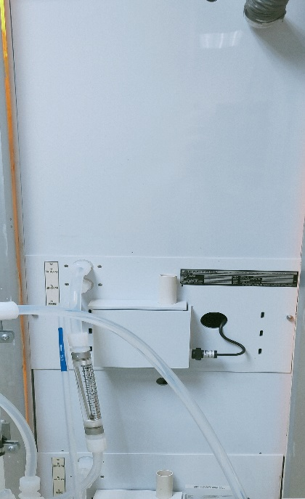
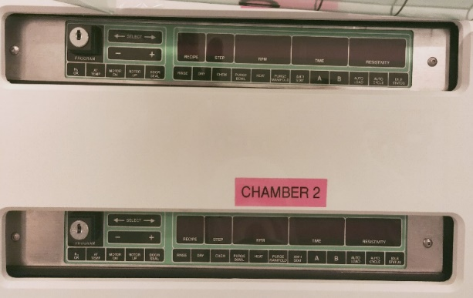
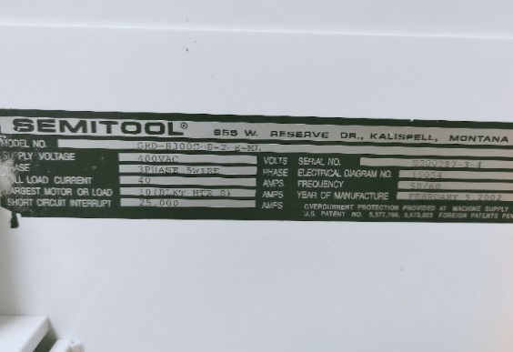
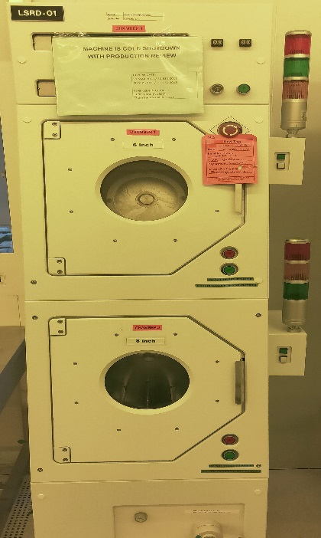
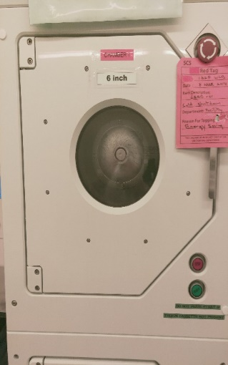
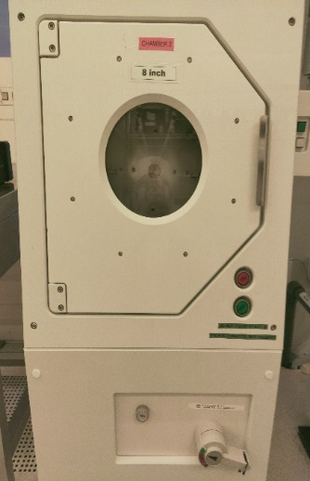
Tool ID: LSRD-01
Machine Rear
Front Side Controller
Manufacturer Info
Main Configuration of LSRD-01:
2 chamber
Top chamber 6” configuration & Bottom chamber 8” configuration
Spin/Rinse/Dry process
Tool Condition : Cold shutdown mode/ working condition
6” chamber
8” chamber
Machine Front

